Slide 1
Week2 Project
Kaiye Chen

Slide 2

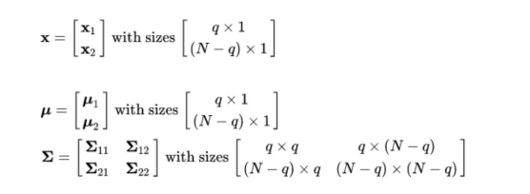
Problem1: Math Provement
Multivariate Distribution:
Partition Matrix:

Slide 3
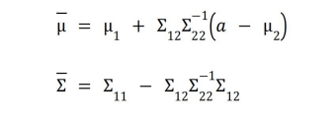

Problem1: Math Provement
Given X₂ = a:
Linear function:

Slide 4
Problem1: Math Provement
Given X₂ = a:
Linear function:

Slide 5
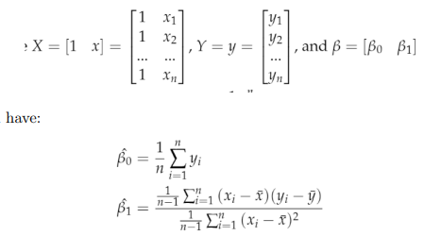
Problem1: Math Provement

Slide 6
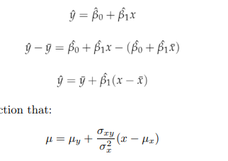
Problem1: Math Provement

Slide 7
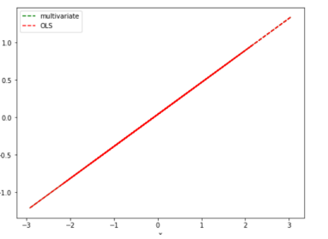
Problem1: Empirical Provement

Slide 8
Problem2: OLS error distribution
t-test(Shapiro-Wilk test):
P = 0.00016
significance level 95%: reject H0
Error term not normally distributed
Consider robust variance or GLS

Slide 9
Problem2: MLE: normal vs t-distribution
Distribution | b0 | b1 | SSE | AIC | BIC
Normal | 0.1198 | 0.6052 | 143.6 | 325.9 | 333.8
Student’s t | 0.1426 | 0.5575 | 143.9 | 318.9 | 329.3

Slide 10
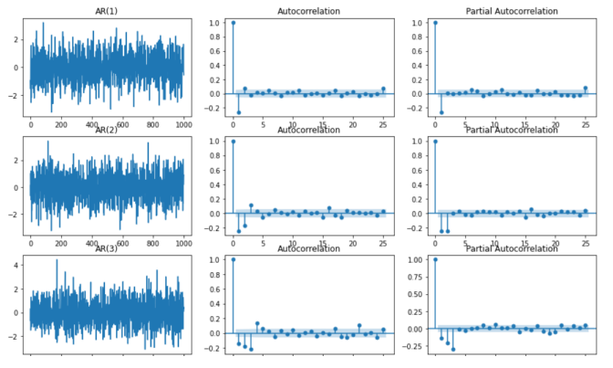
Problem3: AR process

Slide 11
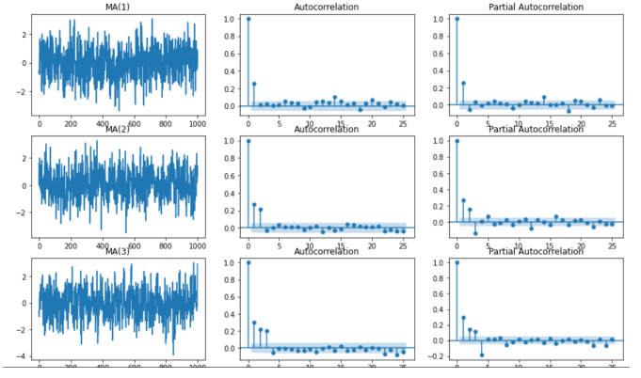
Problem3: MA process

Slide 12
Problem3: Summary
ACF and PACF graphs: number of lag terms = number of terms not decay
Usage: Determine which order of time series should be used

